Slide 1


FPGA-Accelerated Retinex Image Enhancement for Low-Light Conditions
R.M.K. ENGINEERING COLLEGE (An Autonomous Institution) RSM Nagar, Kavaraipettai, Gummidipoondi Taluk, Thiruvallur District -601 206.
Done by
G.S.Anusri - 111721104010
R.Aswini - 111721104014
Ektha Sudhakar Reddy - 111721104036
Under the Guidance of
Mr. Siva Kumar A
Associate Professor
Department of Electronics and Communication Engineering
R.M.K. Engineering College

Slide 2
Contents
Abstract
Objectives
Literature Survey
Existing Work
Proposed Work
Block Diagram
Circuit Diagram
Advantages
Applications
References

Slide 3
Abstract
FPGA implementation of a Retinex-based algorithm designed for enhancing low-light images. The proposed system processes low-light images to produce outputs with improved contrast and enhanced detail visibility. Developed in Verilog for seamless hardware integration, the algorithm decomposes the input image into illumination and reflectance components, applies dynamic range compression, and enhances details to achieve optimal results.

Slide 4
Objectives
FPGA-based system for low-light image enhancement . Implement a Retinex-based algorithm for image decomposition and dynamic range compression .Leverage parallel processing capabilities of FPGAs to achieve real-time performance .Ensure the system preserves image details while enhancing visibility and contrast .Evaluate the design for effectiveness in practical applications, such as surveillance and automotive vision systems.

Slide 5
Literature Survey
S.NO | TITLE | YEAR | DRAWBACK
01 | FPGA Implementation of Image Enhancement Algorithms for Real-Time Applications” | 2020 | Latency in High-Resolution Processing
02 | DA-DRN: Degradation-Aware Deep Retinex Network for Low-Light Image Enhancement | 2021 | Energy Consumption
03 | Lightweight CNN-Based Low-Light-Image Enhancement System on FPGA Platform | 2023 | Model Complexity
04 | FPGA-based low-light image enhancement using Retinex algorithm and coarse-grained reconfigurable architecture | 2024 | Lack of Advanced Color Correction
.

Slide 6
Existing Work
Histogram Equalization (HE) methods adjust the dynamic range of low-light images but provide limited enhancement, as they fail to consider the image's overall features, resulting in suboptimal improvements in contrast and detail visibility.

Slide 7
Proposed Work
Retinex-based low-light image enhancement methods have become more popular than histogram equalization (HE) techniques. These methods decompose an image into reflectance and illumination channels, which are enhanced and recombined for improved visual quality.

Slide 8
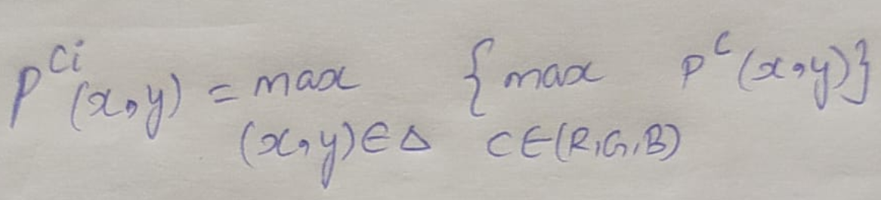
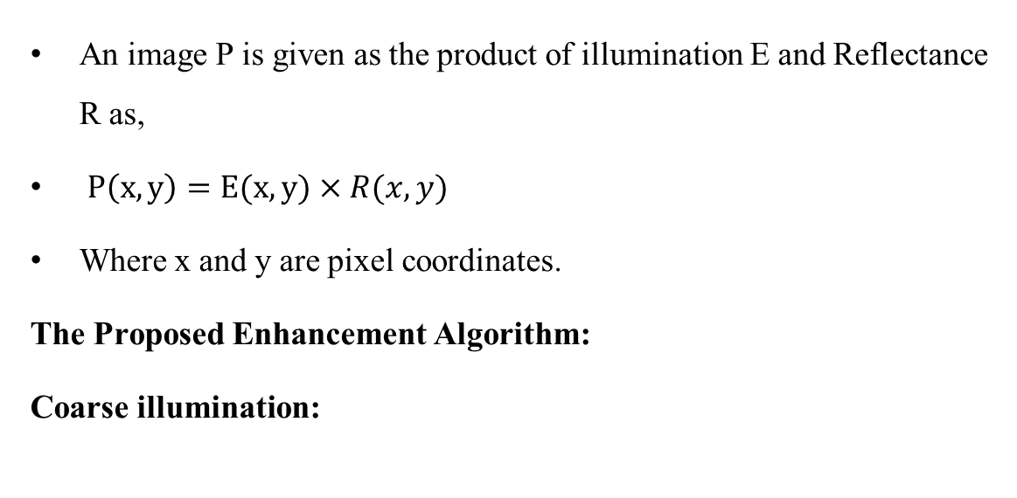
The Retinex Model
An image P is given as the product of illumination E and Reflectance R as,
$P\left(x,y\right)=E(x,y)×R(x,y)$
Where x and y are pixel coordinates.
The Proposed Enhancement Algorithm:
Coarse illumination:

Slide 9
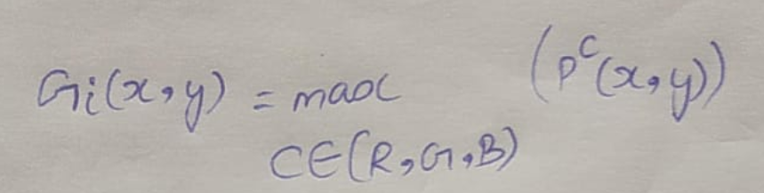
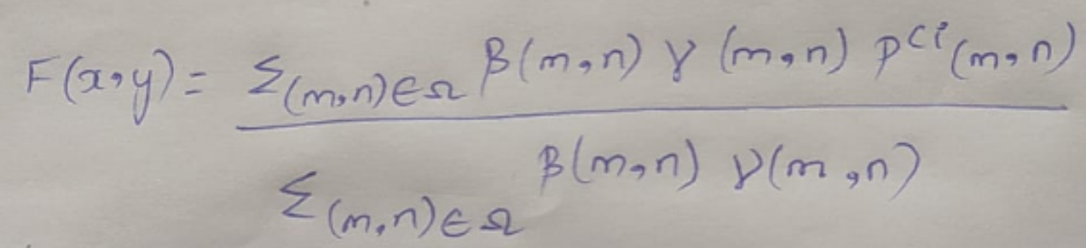
An edge-preserving filter is proposed for efficient illumination estimation.
Guidance Image:
Filtered output F:

Slide 10
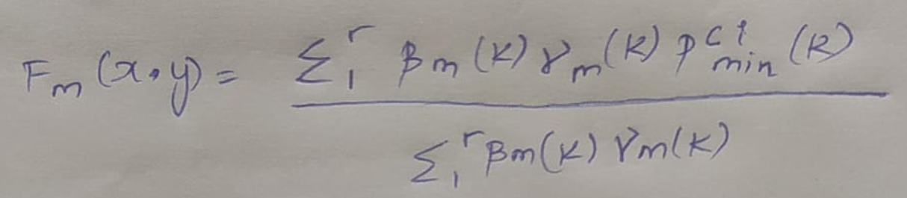
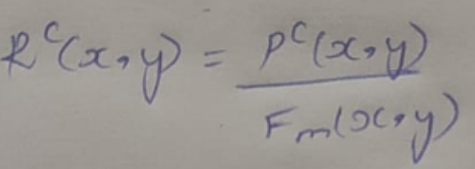
Refined illumination:
Reflectance:

Slide 11
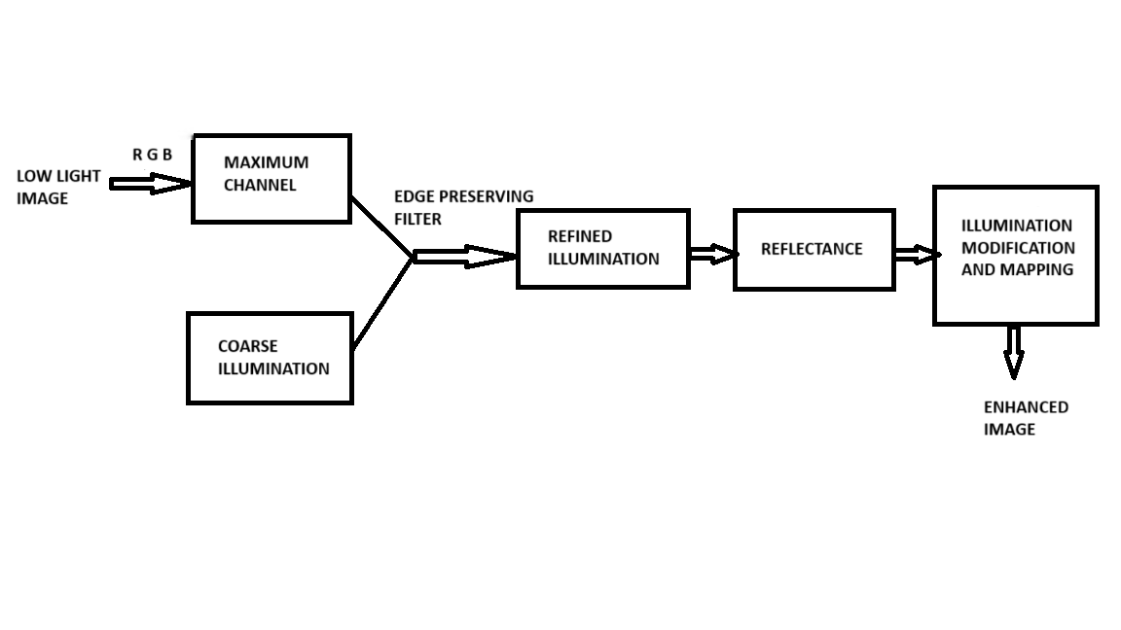
The Block Diagram

Slide 12
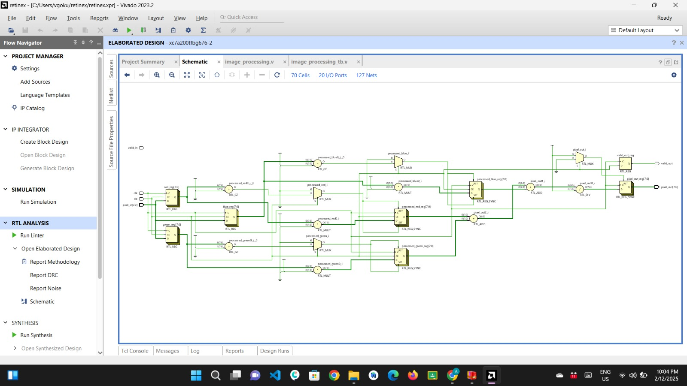
The Circuit Diagram

Slide 13
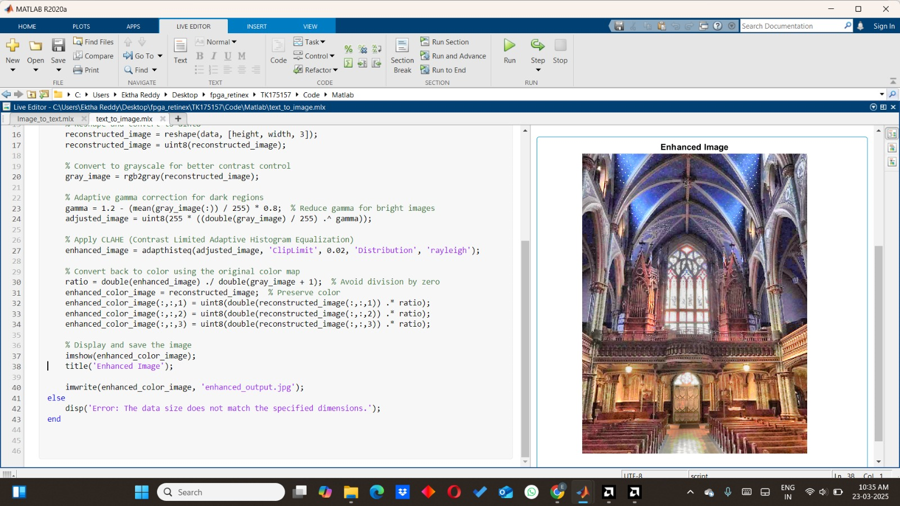
Output

Slide 14
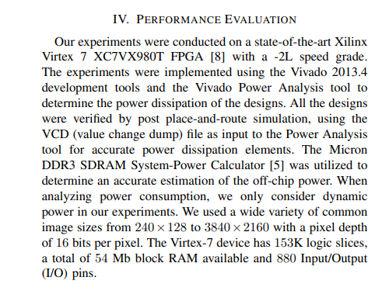
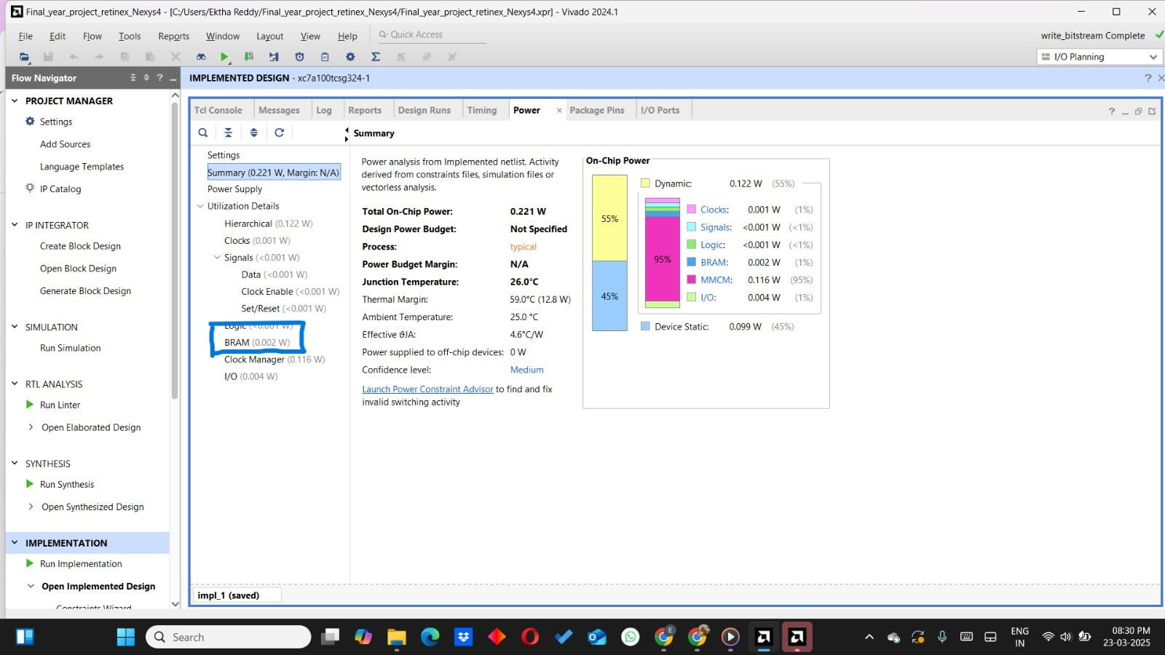
Comparison
Retinex based algorithm
Histogram equalization
The Block RAM used in our project is around 0.002 watts and the performance evaluation Block RAM of histogram equalization is 54mb which is around 1 watts.

Slide 15
Advantages
Real-Time Processing
Energy Efficiency
Improved Image Quality
Scalability
Parallel Processing Capabilities
Versatility
Reduced Noise Artifacts
Wide Application Range
Adaptability to Hardware Constraints

Slide 16
Applications
Surveillance Systems
Automotive Night Vision
Medical Imaging
Satellite and Aerial Imaging
Robotics and Computer Vision
Security and Surveillance in Drones
Consumer Electronics
Industrial Inspection
Autonomous Vehicles

Slide 17
REFERENCES
[1] H. Wang et al., “SFNet-N: An improved SFNet algorithm for semantic segmentation of low-light autonomous driving road scenes,” IEEE Trans. Intell. Transp. Syst., vol. 23, no. 11, pp. 21405–21417, Nov. 2022.
[2] E. Khatab, A. Onsy, M. Varley, and A. Abouelfarag, “Vulnerable objects detection for autonomous driving: A review,” Integration, vol. 78, pp. 36–48, May 2021.
[3] W. Wang, X. Wu, X. Yuan, and Z. Gao, “An experiment-based review of low-light image enhancement methods,” IEEE Access, vol. 8, pp. 87884–87917, 2020.
[4] D. J. Jobson, Z. Rahman, and G. A. Woodell, “Properties and performance of a center/surround retinex,” IEEE Trans. Image Process., vol. 6, pp. 451–462, 1997.
[5] D. J. Jobson, Z. Rahman, and G. A. Woodell, “A multiscale retinex for bridging the gap between color images and the human observation of scenes,” IEEE Trans. Image Process., vol. 6, pp. 965–976, 1997.

Slide 18
THANK YOU

